Slide 1
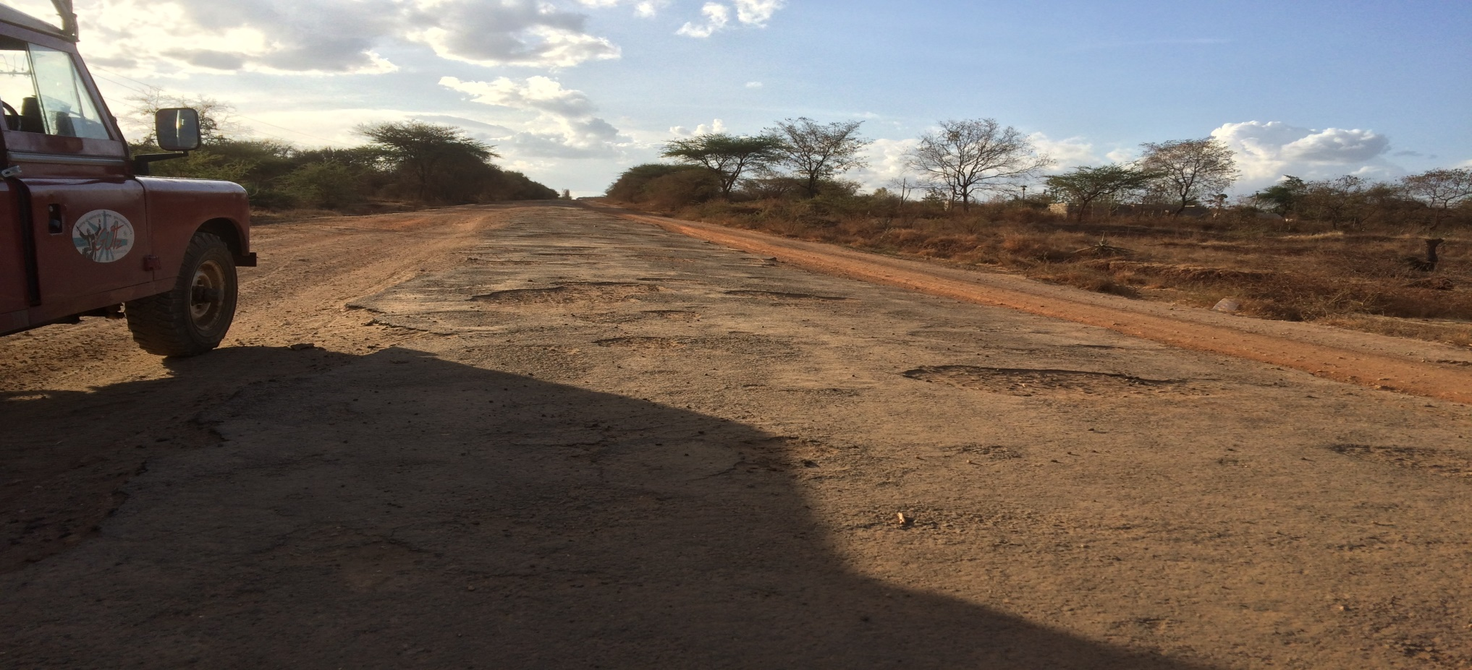
8 people die every day on Kenyan roads.

Slide 2
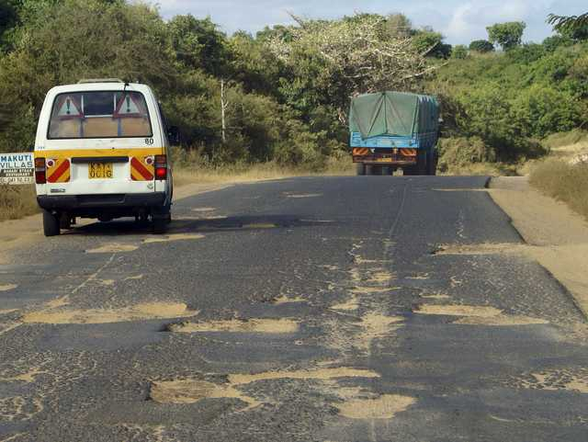
Kshs 300 billion is lost every year due to road accidents in Kenya.

Slide 3
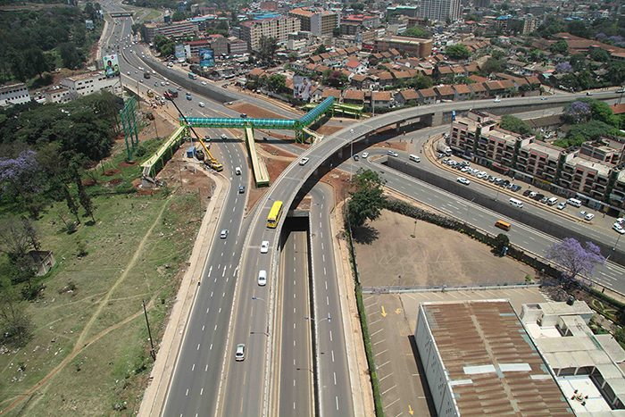
Be a part of the solution.

Slide 4
Make a report.

